Slide 1
A common neural basis for contrast and motion coherence discrimination
Dan Birman
Frisem 2017-06-26

Slide 4
Contrast

Slide 5
Coherence

Slide 6
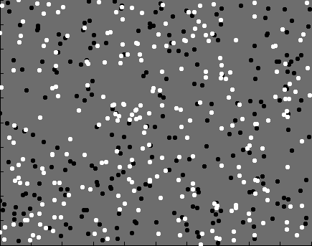

Slide 7
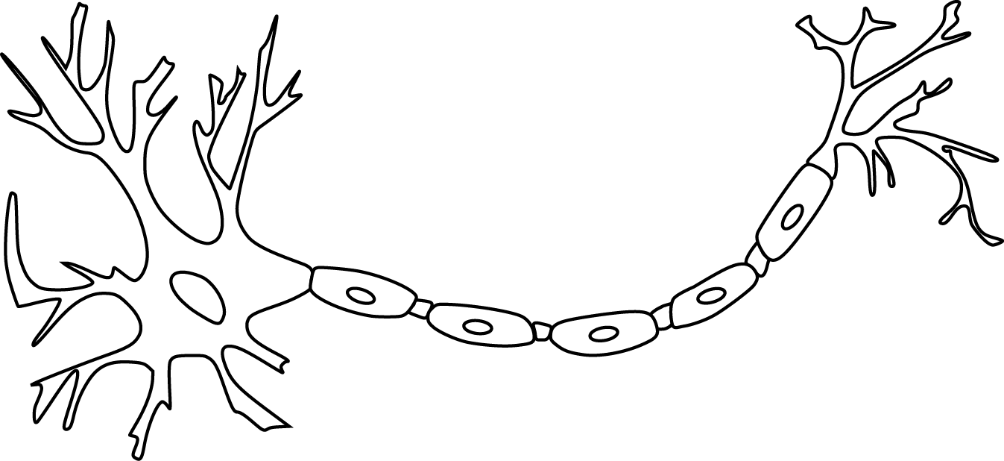

Slide 9
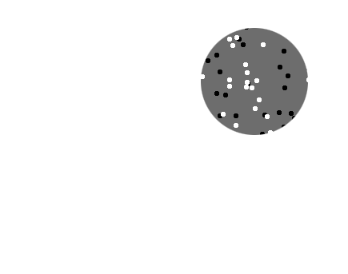
Receptive field

Slide 10
Receptive field

Slide 11
Population
Receptive field

Slide 13
~ 2.5 mm
~ 2.5 mm
~ 2.5 mm

Slide 14
~ 2.5 mm
~ 2.5 mm
~ 2.5 mm
Millions of neurons

Slide 16
Representation of contrast?
Boynton et al. 1999

Slide 17
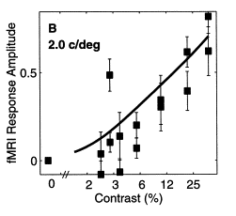
Representation of contrast?
Boynton et al. 1999

Slide 18
Representation of contrast?
Boynton et al. 1999
Representation of coherence?
Rees and Koch 2000

Slide 19
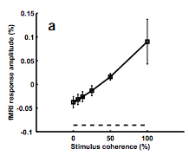
Representation of contrast?
Boynton et al. 1999
Representation of coherence?
Rees and Koch 2000

Slide 22
Contrast

Slide 23
Contrast

Slide 24
Contrast

Slide 25
Contrast
Coherence

Slide 26
Contrast
Coherence

Slide 27
Goal: A model of how voxels represent (encode) contrast and motion coherence

Slide 28
Goal: A model of how voxels represent (encode) contrast and motion coherence
Voxel representation as measured from cortical signals with fMRI
Prediction and comparison to a behavioral measure of visibility

Slide 29
Goal: A model of how voxels represent (encode) contrast and motion coherence
Voxel representation as measured from cortical signals with fMRI
Prediction and comparison to a behavioral measure of visibility

Slide 30
Goal: A model of how voxels represent (encode) contrast and motion coherence
Voxel representation as measured from cortical signals with fMRI
Prediction and comparison to a behavioral measure of visibility

Slide 38
Cortical measurements: task at fixation
11 observers, asynchronous task at fixation
800+ trials (20 per experimental condition)
1 hr retinotopy
4 x 2 hr scanning sessions

Slide 39
Area V1
Area MT

Slide 40
Within-subject analysis: display average across subjects
Timecourses were averaged across ROIs
Deconvolution (GLM/finite impulse response) used to obtain separated per-condition measurements

Slide 41
Contrast
Coherence

Slide 42
Contrast
Stimulus length
Coherence

Slide 45
Contrast

Slide 46
Contrast
Coherence

Slide 47
Contrast
Stimulus length
Coherence

Slide 53
Goal: A model of how voxels represent (encode) contrast and motion coherence
Voxel representation as measured from cortical signals with fMRI
Prediction and comparison to a behavioral measure of visibility

Slide 54
Goal: A model of how voxels represent (encode) contrast and motion coherence
Voxel representation as measured from cortical signals with fMRI
Prediction and comparison to a behavioral measure of visibility

Slide 61
Sensitivity = Response / Noise

Slide 65
Goal: A model of how voxels represent (encode) contrast and motion coherence
Voxel representation as measured from cortical signals with fMRI
Prediction and comparison to a behavioral measure of visibility

Slide 66
Goal: A single model of how voxels represent (encode) contrast and motion coherence
Voxel representation as measured from cortical signals with fMRI
Prediction and comparison to a behavioral measure of visibility

Slide 67
Goal: A single model of how voxels represent (encode) contrast and motion coherence
Voxel representation as measured from cortical signals with fMRI
Prediction and comparison to a behavioral measure of visibility

Slide 68
Goal: A single model of how voxels represent (encode) contrast and motion coherence
Voxel representation as measured from cortical signals with fMRI
Evidence for similar neural response functions to contrast and motion coherence
Prediction and comparison to a behavioral measure of visibility

Slide 69
Goal: A single model of how voxels represent (encode) contrast and motion coherence
Voxel representation as measured from cortical signals with fMRI
Evidence for similar neural response functions to contrast and motion coherence
Prediction and comparison to a behavioral measure of visibility

Slide 70
Goal: A single model of how voxels represent (encode) contrast and motion coherence
Voxel representation as measured from cortical signals with fMRI
Evidence for similar neural response functions to contrast and motion coherence
Prediction and comparison to a behavioral measure of visibility
Judgments of contrast and motion coherence appear to be read out from early visual cortex and MT in a similar way

Slide 71

Thanks!
Funding?
Other things?
Justin Gardner

